Slide 1
Natural Language Processing IST 664/CIS 668
Week 2 Lectures
Corpus Statistics and Language Modeling
1

Slide 2
Natural Language Processing IST 664/CIS 668
Week 2 - Readings
Complete this reading before starting the Lab Sessions:
From the NLTK book, Chapter 1: Language Processing and Python, sections 3.1 Frequency Distributions and 3.3 Collections and Bigrams
Further readings on Python before next week
Read the sections on Python 4.1 – 4.4, Conditionals, Operating on Every Element, Nested Code Blocks, and Looping with Conditions
If you want more information on Python, you may choose to read additional sources, such as Python Wikibooks
2

Slide 3
Natural Language Processing IST 664/CIS 668
Week 2 - Resources
Google N-gram viewer
State of the Union (SOTU) speeches by Nate Silver.
Authenticity in America: Class Distinctions in Potato Chip Advertising, by Joshua Freedman and Dan Jurafsky.
3

Slide 4
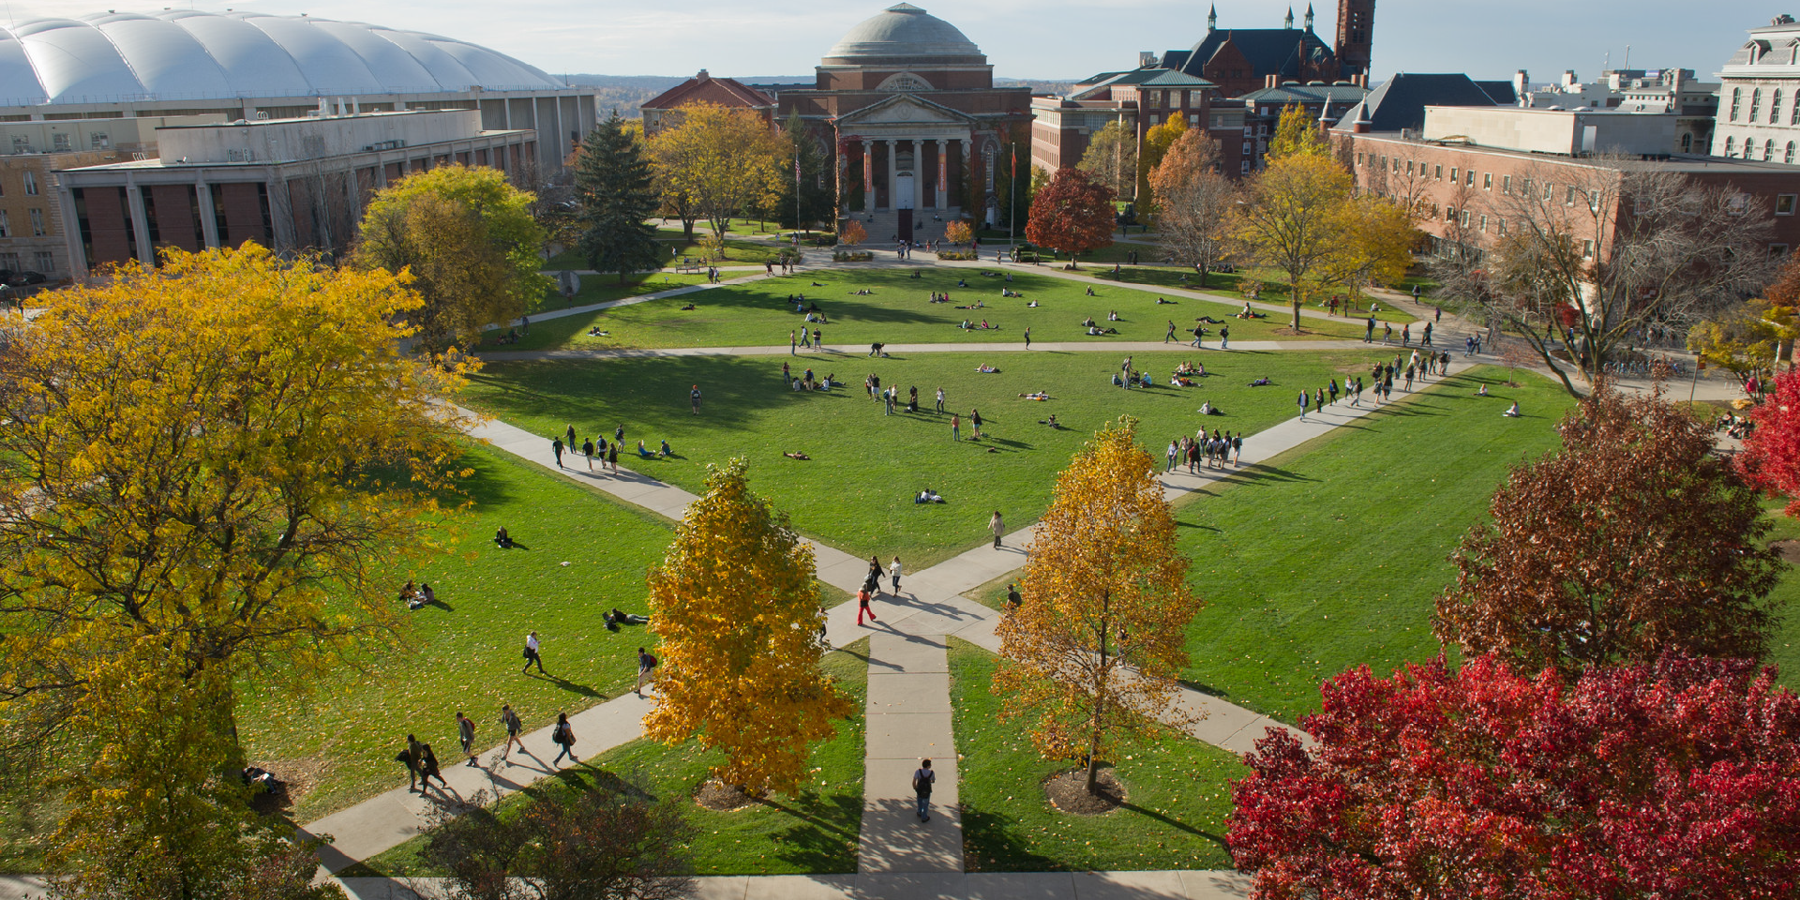
Corpus Statistics: Unigram/Word Frequencies

Slide 5
What Is Corpus
Statistics/Linguistics?
A methodology to process text and provide information about the text
The corpus is a collection of text
­ Utilizes a representative sample of machine-readable text of a language or a particular variety of text or language
Statistical analysis
­ Word frequencies, referred to as unigram frequencies
­ Collocations of words: bigrams, trigrams, etc.
Often used in “digital humanities” as ways to characterize properties of corpora
­ Where the “properties” of interest may govern choices of words to highlight

Slide 6
Word Frequencies
Count the number of each token appearing in the corpus (or sometimes single document).
A frequency distribution is a list of all tokens with their frequency, usually sorted in the order of decreasing frequency.
They are used to make “word clouds,” where the most frequent words will be made bigger.

Slide 7
How Many Words in a Corpus?
Let N be the number of tokens (words plus other symbols).
Let V be the size of the vocabulary (the number of distinct tokens).
 | Tokens = N | Types = |V|
Switchboard phone conversations | 2.4 million | 20 thousand
Shakespeare | 884,000 | 31 thousand
Google N-grams | 1 trillion | 13 million
Also see xkcd.com/1133/
How to describe rocket only using words from most common 1,000
from Dan Jurafsky

Slide 8
Zipf’s Law
In a natural language corpus, the frequency of any word is inversely proportional to its rank in a frequency table.
Rank (r): The numerical position of a word in a list sorted by decreasing frequency (f).
Zipf (1949) “discovered” that:
­ Examples if k is 1:
f r = k (for constant k)
­ Most frequent word (r = 1) is twice as frequent as second most frequent
­ Most frequent (r = 1) is three times as frequent as third most frequent, etc.

Slide 9
Zipf’s Law
For example, in the Brown Corpus of American English text,
­ the word “the” is the most frequently occurring word and, by itself, accounts for nearly 7% of all word occurrences (69,971 out of slightly over 1 million),
­ the second-place word “of” accounts for slightly over 3.5% of the words (36,411 occurrences),
­ followed by “and” (28,852).
—from Wikipedia

Slide 10
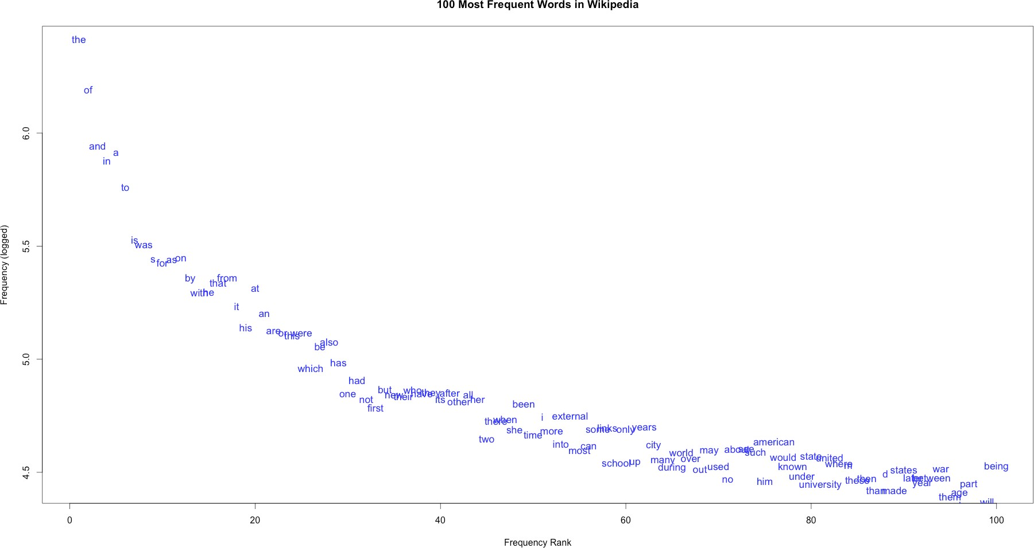

A sample of 36.8 million words from Wikipedia, over 580,000 word types, nearly half (280,000) occur just once in the sample (image and this data from http://wugology.com/zipfs-law/)

Slide 11
Zipf’s Law Impact
on Language Analysis
Good news: Stopwords (commonly occurring words such as “the”) will account for a large fraction of text, so eliminating them greatly reduces the number of words in a text.
Bad news: For most words, gathering sufficient data for meaningful statistical analysis is difficult since they are extremely rare.

Slide 12
Exercise 2.3.2
The basis of a word cloud is to make a frequency distribution of words in a document, usually removing common words like “the” and “a.” Of course, there is an additional artistic component of a word cloud that makes the sizes to show the most frequent words as larger, and chooses colors and word layouts to make an interesting graphic.
Search the Internet and observe some of the word clouds that people have made. Pick one of the examples and look at the two most frequent (largest) words. Are they similar in size? Or does one word stand out? Looking at the words overall, what do you think is the main topic of the document?
Be prepared to share your results with the class.
12

Slide 13
Corpus Statistics: Bigram Frequencies and Mutual Information (MI)

Slide 14
Bigrams
Examples of bigrams are any two words that occur together in the text.
­ In “two great and powerful groups of nations,”
­ the bigrams are “two great,” “great and,” “and powerful,” etc.
The frequency of an N-gram is the percentage of times the N- gram occurs in all the N-grams of the corpus and could be useful in corpus statistics.
­ For bigram xy:
­ Count of bigram xy/count of all bigrams in the corpus
­ Examples are in the Google N-gram corpus
2

Slide 15
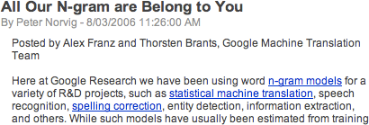
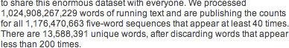
Google N-Gram Release
3

Slide 16
Example Data
Examples of 4-gram frequencies from the Google
N-gram release
­ serve | as | the | incoming 92
­ serve | as | the | incubator 99
­ serve | as | the | independent 794
­ serve | as | the | index 223
­ serve | as | the | indication 72
­ serve | as | the | indicator 120
­ serve | as | the | indicators 45
­ serve | as | the | indispensable 111
­ serve | as | the | indispensable 40
­ serve | as | the | individual 234
4

Slide 17
Google Ngram Viewer
In 2010, Google placed online the Ngram Viewer that would display graphs of N-gram frequencies of one or more N-grams, based on a corpus defined from Google Books.
­ https://books.google.com/ngrams
­ And see also the “About NGram Viewer” link
5

Slide 18
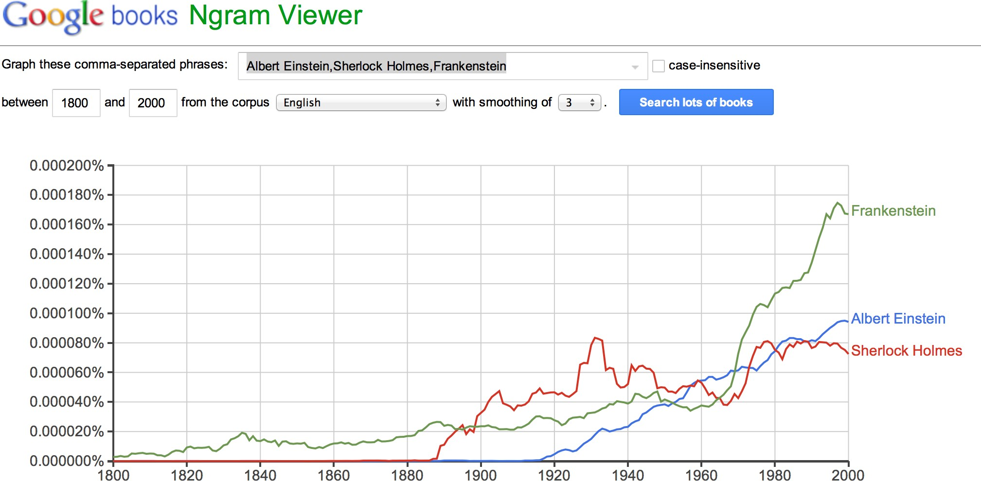
Google Ngram Viewer
6

Slide 19
Additional Corpus Measures
Recall that, so far, we have looked at one measure involving bigrams (and these definitions can be extended to N-grams).
­ Bigram frequency: percentage occurrence of the bigram in the corpus
­ Seen in the Google Ngram data
Other measures can be defined about the occurrences of bigrams in a corpus.
­ Mutual information, …
­ More of these can be found in the NLTK
7

Slide 20
Corpus Statistics:
Mutual Information (MI)
Mutual information computes the probability of two words occurring in sequence.
Given a pair of words, it compares the probability that the two occur together as a joint event with the probability that they occur individually and that their co-occurrences are simply the result of chance.
­ The more strongly connected two items are, the higher will be their MI value.
8

Slide 21
Mutual Information
Based on the work of Church and Hanks (1990), generalizing MI from information theory to apply to words in sequence
­ They used the terminology association ratio
P(x) and P(y) are estimated by the number of observations of x and
y in a corpus and normalized by N, the size of the corpus
P(x,y) is the number of times that x is followed by y in a window of
w words
Mutual information score (also sometimes called PMI, pointwise mutual information):
PMI(x,y) = log₂ (P(x,y)/P(x)P(y))
9

Slide 22
MI Values Based on 145
Wall Street Journal Articles
x | freq (x) | y | freq (y) | freq (x,y) | MI
Gaza | 3 | Strip | 3 | 3 | 14.42
joint | 8 | venture | 4 | 4 | 13.00
Chapter | 3 | 11 | 14 | 3 | 12.20
credit | 15 | card | 11 | 7 | 11.44
average | 22 | yield | 7 | 5 | 11.06
appeals | 4 | court | 47 | 4 | 10.45
.....
said | 444 | it | 346 | 76 | 5.02
10

Slide 23
Uses of Mutual Information
Can be used to characterize text in corpus statistics, but also in other NLP processes
­ Idiomatic phrases for machine translation
­ Sense disambiguation (both statistical and symbolic approaches)
­ Error detection and correction in speech analysis and spell-checking
Used for distributional semantics in “deep learning”
Used in non-text applications such as comparing features in machine learning
11

Slide 24
Exercise 2.3.4
List all the bigrams occurring in the phrase:
“For we, the people, understand that our country”.
**Note**
Lowercase words and remove punctuation prior to listing the bigrams.
Be prepared to share your results with the class.
12

Slide 25
Corpus Statistics:
Examples

Slide 26
Characterizing Text
One method of digital humanities is to characterize text with corpus statistics
­ Collect frequencies of words and bigrams or mutual information scores
Use these to characterize some aspect of the text, often used to compare two or more texts
Examples of characteristics
­ Contents, topics
­ Style, informal vs. formal, differences in gender usage

Slide 27
Example 1:
SOTU Speeches
Example of word frequencies for comparison and characterization of text See the State of the Union (SOTU) Speeches by Nate Silver
http://fivethirtyeight.com/features/obamas-sotu-clintonian-in-good-way/
Comparison questions:
­ How do the topics in the SOTU speeches of one president compare with another’s?
­ In the article, several different comparison questions are discussed.
Methodology: choose topic words of interest and plot frequencies of these words vs. different speeches

Slide 28
Example 2:
Potato Chip Ad Language
A student in an NLP class with Dan Jurafsky collected text from regular and gourmet potato chip bags.
https://web.stanford.edu/~jurafsky/freedmanjurafsky2011.pdf
“Our goal, then, is to explore whether advertising on chips targeted toward consumers of high socioeconomic status uses different language than that on chips designed to appeal to lower status consumers. We hope to better understand how advertisers distinguish the concepts of food for the upper class and the working class or lower-middle class in America.”
Methodology: The student looked at the complexity of the text, using a specific measure based on word frequencies.

Slide 29
Language Models/
N-Gram Models

Slide 30
Language Models
The goal of a language model is to assign a probability that a sentence (or phrase) will occur in natural uses of the language.
Why?
­ Machine translation
­ P(high winds tonight) > P(large winds tonight)
­ Spell correction
­ The office is about 15 minuets from my house
­ P(about 15 minutes from) > P(about 15 minuets from)
­ Speech recognition
­ P(I saw a van) >> P(eyes awe of an)
­ And other NLP applications
Corpus statistics captures a static view of a corpus, but language models use a corpus to predict how words occur in sentences.

Slide 31
Language Models
Goal: compute the probability of a sentence or sequence of words
­ P(W) = P(w₁,w₂,w₃,w₄,w₅…w_{n})
Related task: probability of an upcoming word
­ P(w₅|w₁,w₂,w₃,w₄)
­ Conditional probability that w₅ occurs, given that we know that w₁,w₂,w₃,w₄
already occurred
A model that computes either of these:
­ P(W) or P(w_{n}|w₁,w₂…w_{n–1}) is called a language model
We might call this a grammar because it predicts the
(word-level) structure of the language, but language model is the standard terminology

Slide 32
Chain Rule Applied
Compute the probability of a sentence by computing the joint probability of all the words conditioned by the previous words.
P(w₁w₂ w_{n} ) = P(w_{i} | w₁w₂ w_{i 1})
i
Example: P(“its water is so transparent”) =
P(its) × P(water|its) × P(is|its water) × P(so|its water is) × P(transparent|its water is so)
With our corpus, we can just compute the probability that something occurred by counting its occurrences and dividing by the total number.
P(the | its water is so transparent that) =
Count(its water is so transparent that the)
Count(its water is so transparent that)
But there are way too many unique English sentences in any realistic corpus for this to work! We’ll never see enough data.

Slide 33
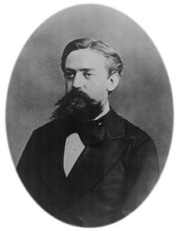
Markov Assumption
Instead, we make the simplifying Markov assumption that we can predict the next word based on only one word previous:
P(the | its water is so transparent that) ≈ P(the | that)
Or perhaps two words previous:
Andrei Markov
P(the | its water is so transparent that) ≈ P(the | transparent that)

Slide 34
N-Gram Models
Unigram model(word frequencies): The simplest case is that we predict a sentence probability just based on the probabilities of the words with no preceding words.
P(w₁w₂ …w_{n} ) ≈ ∏ P(w_{i} )
i
Bigram model (two word frequencies): Prediction is based on one previous word:
P(w_{i} | w₁w₂ …w_{i−1}) ≈ P(w_{i} | w_{i−1})

Slide 35
N-Gram Models
We can extend to trigrams, 4-grams, and 5-grams.
­ Each higher number will get a more accurate model, but it will be harder to find examples of the longer word sequences in the corpus
In general, this is an insufficient model of language because:
­ Language has long-distance dependencies
­ “The computer that I had just put into the machine room on the fifth floor crashed.”
­ The last word crashed is not very likely to follow the word floor, but it is likely to be the main verb of the word computer
But we can often get away with N-gram models.

Slide 36
N-Gram Predictive Probabilities
For N-grams, we need the conditional probability:
P(<next word>|<preceding word sequence of length n>) (e.g., P(the|They picnicked by))
We define this as:
­ The observed frequency (count) of the whole sequence divided by
­ The observed frequency of the preceding, or initial, sequence (sometimes called the maximum likelihood estimation (MLE):
P(<next word>|<preceding word sequence of length n>)
= Count (<preceding word sequence> <next word>)
/ Count (<preceding word sequence>)
­ Example: Count (They picnicked by the) / Count (They picnicked by)

Slide 37
Language Modeling
Examples

Slide 38
Example of Bigram
Predictive Probabilities
Divide the count of the bigram
₎ ₌ count(w_{i−1},w_{i} )
by the count of the first word:
P(w | w
i i−1
count(w )
i−1
Example mini-corpus of three sentences, where we have separated sentences, and we include the sentence tags in order to represent the beginning and end of the sentence:
<S> I am Sam </S>
<S> Sam I am </S>
<S> I do not like green eggs and ham </S>
Bigram predictive probabilities:
P ( I | <S>) = 2/3 = .67 (probability that I follows <S>)
P ( </S> | Sam ) = 1/2 = .5
P ( Sam | <S> ) = 1/3 = .33
P ( Sam | am ) = 1/2 = .5
P ( am | I ) = 2/3 = .67
2

Slide 39
Example Using Bigram Predictive Probabilities to Predict
the Probabilities of Sentences
Berkeley Restaurant Project collected online questions from people about restaurants in the Berkeley area.
Some example sentences:
­ can you tell me about any good cantonese restaurants close by
­ mid-priced thai food is what i’m looking for
­ tell me about chez panisse
­ can you give me a listing of the kinds of food that are available
­ i’m looking for a good place to eat breakfast
­ when is caffe venezia open during the day
3

Slide 40
Raw Bigram Counts From the Corpus
Out of 9,222 sentences, showing counts that the word on the left is followed by the word on the top
 | i | want | to | eat | chinese | food | lunch | spend
i | 5 | 827 | 0 | 9 | 0 | 0 | 0 | 2
want | 2 | 0 | 608 | 1 | 6 | 6 | 5 | 1
to | 2 | 0 | 4 | 686 | 2 | 0 | 6 | 211
eat | 0 | 0 | 2 | 0 | 16 | 2 | 42 | 0
chinese | 1 | 0 | 0 | 0 | 0 | 82 | 1 | 0
food | 15 | 0 | 15 | 0 | 1 | 4 | 0 | 0
lunch | 2 | 0 | 0 | 0 | 0 | 1 | 0 | 0
spend | 1 | 0 | 1 | 0 | 0 | 0 | 0 | 0
4

Slide 41
Bigram Predictive Probabilities
Unigram counts:
i | want | to | eat | chinese | food | lunch | spend
2533 | 927 | 2417 | 746 | 158 | 1093 | 341 | 278
5

Slide 42
Bigram Predictive Probabilities
Resulting bigram predictive probability
(bigram counts/unigram counts of first words):
 | i | want | to | eat | chinese | food | lunch | spend
i | 0.002 | 0.33 | 0 | 0.0036 | 0 | 0 | 0 | 0.00079
want | 0.0022 | 0 | 0.66 | 0.0011 | 0.0065 | 0.0065 | 0.0054 | 0.0011
to | 0.00083 | 0 | 0.0017 | 0.28 | 0.00083 | 0 | 0.0025 | 0.087
eat | 0 | 0 | 0.0027 | 0 | 0.021 | 0.0027 | 0.056 | 0
chinese | 0.0063 | 0 | 0 | 0 | 0 | 0.52 | 0.0063 | 0
food | 0.014 | 0 | 0.014 | 0 | 0.00092 | 0.0037 | 0 | 0
lunch | 0.0059 | 0 | 0 | 0 | 0 | 0.0029 | 0 | 0
spend | 0.0036 | 0 | 0.0036 | 0 | 0 | 0 | 0 | 0
6

Slide 43
Using N-Grams for Sentences
n
For a bigram grammar: P(w_{k} | w_{k 1} )
k =1
­ P(sentence) can be approximated by multiplying all the bigram probabilities in the sequence
Example of using bigram probabilities to compute the probability of a sentence:
P(I want to eat Chinese food) =
P(I|<S>) P(want|I) P(to|want) P(eat|to) P(Chinese|eat) P(food|Chinese)
7

Slide 44
More Bigrams From
the Restaurant Corpus
Eat on | .16 | Eat Thai | .03
Eat some | .06 | Eat breakfast | .03
Eat lunch | .06 | Eat in | .02
Eat dinner | .05 | Eat Chinese | .02
Eat at | .04 | Eat Mexican | .02
Eat a | .04 | Eat tomorrow | .01
Eat Indian | .04 | Eat dessert | .007
Eat today | .03 | Eat British | .001
Examples due to Rada Mihalcea
8

Slide 45
Additional Bigrams
<S> I | .25 | Want some | .04
<S> I’d | .06 | Want Thai | .01
<S> Tell | .04 | To eat | .26
<S> I’m | .02 | To have | .14
I want | .32 | To spend | .09
I would | .29 | To be | .02
I don’t | .08 | British food | .60
I have | .04 | British restaurant | .15
Want to | .65 | British cuisine | .01
Want a | .05 | British lunch | .01
9

Slide 46
Computing Sentence Probabilities
P ( I want to eat British food ) = P ( I | <S> ) P ( want | I ) P ( to | want
) P ( eat | to ) P ( British | eat ) P ( food | British ) = .25 × .32 × .65 ×
.26 × .001 × .60 = .000080
Vs.
P ( I want to eat Chinese food ) = .00015
Probabilities seem to capture “syntactic” facts, “world knowledge”
­ Eat is often followed by a noun
­ British food is not too popular
N-gram models can be trained by counting and normalization
10

Slide 47
Language Modeling
Smoothing

Slide 48
Using N-Gram Probabilities in a Language Model:
Why Do We Need Smoothing?
Every N-gram training matrix is sparse, even for very large corpora (remember Zipf’s law).
­ There are words that don’t occur in the training corpus that may occur in future text.
­ These are known as the unseen words.
Whenever a probability is 0, it will multiply the entire sequence to be 0.
Solution: Estimate the likelihood of unseen N-grams, and include a small probability for unseen words.

Slide 49
Intuition of Smoothing
(From Dan Klein)
When we have sparse statistics:
P(w|denied the) 3 allegations
2 reports
1 claims
1 request
Allegations
Reports
Attack
Man Outcome
Claims
Request
…
7 total
Steal probability mass to generalize better:
P(w|denied the)
2.5 allegations
1.5 reports
0.5 claims
0.5 request 2 other
7 total
s
on
i
t a
eg
l
l
a
Allegations
Outcome
Reports
Attack
Man
…
Claims
Request

Slide 50
Smoothing
Add-one smoothing
­ Given: P(w_{n}|w_{n–1}) = C(w_{n–1}w_{n})/C(w_{n–1})
­ Add 1 to each count: P(w_{n}|w_{n–1}) = [C(w_{n–1}w_{n}) + 1]/[C(w_{n–1}) + V]
Back-off smoothing for higher-order N-grams
­ Notice that:
­ N-grams are more precise than (N–1) grams
­ But also, N-grams are sparser than (N–1) grams
­ How to combine things?
­ Attempt N-grams and back off to (N–1) if counts are not available
­ Example: attempt prediction using 4-grams, and back off to trigrams (or bigrams, or unigrams) if counts are not available
More complicated techniques exist: in practice, NLP language models use Knesser-Ney smoothing

Slide 51
Language-Modeling Toolkit
Language-modeling tools help you define your language models by making those tables and calculating the probabilities.
SRI language modeling:
­ http://www.speech.sri.com/projects/srilm/
­ http://www.speech.sri.com/projects/srilm/papers/icslp2002- srilm.pdf
­ A conference paper that gives an overview of the toolkit

Slide 52
Exercise 2.4.4
Download the Word document “nlp_lecture_2-4-4_bigram_exercise” located on Blackboard in the Week 2 Lectures folder. This file contains an excerpt from an inauguration speech.
Choose one of the following groups of bigrams below (A, B, or C) and compute the bigram predictive probabilities, where for a bigram “w1 w2”, this is the probability that w2 follows w1 in the corpus. Recall that the definition of the bigram probability (from slide 9 in the lecture), for a bigram "w1 w2", P(w2 | w1) = count of "w1 w2" / count of w1.
Here is an example similar to the first group. Suppose that we want to compute the bigram probability of "we bear". We can count to see that there is only one occurrence of the bigram "we bear", but there are 21 occurrences of the first word "we". So the bigram probability is the ratio 1/21. (This makes sense because the probability that the word “bear” follows the word “we” in this document is 1/21.)
** Note** Ignore capitalization in your counting.
Group A: “we ,”; “we will”; “we know”
Group B” “our people”; “our journey”
Group C: “believe that”
Be prepared to share your results with the class.

Slide 53
Lab Session – Week 2: Bigram Frequencies & Mutual Information (MI)
Please download Lab files located on BB in the folder: Lectures - Week 2.
labweek2examples.bigrams.txt
lab1.setup.text.doc
lab2.morepython2.doc
lab3.filterwords.doc
lab4.bigramfreq.mi.doc
For this lab session, you may want to use the file“labweek2examples.bigrams.txt“ to copy/paste the Python examples as you try them out.
**Note**
When you are done using Jupyter Notebook, you can close the browser windows and terminate the jupyter server in the terminal or command prompt window by typing “ctrl C" and then type “Y” for Yes to shut down the server.

Slide 54
Lab Session – Week 2: Bigram Frequencies & Mutual Information (MI)
Lab Session - Week 2 Homework
As demonstrated in the preceding lab sessions, choose a file that you want to work on—either one of the files from the book corpus or one from the Gutenberg corpus.
Make a bigram finder and experiment with whether to apply the filters or not. Run the scoring with both the raw frequency and the pmi scorers and compare results.
Choose one of your top 20 frequency lists to report on. Submit a report summary that includes the corpus you chose and what bigram filters and scorer you used. Put this detail and the frequency list in your response. Also include any observations and lessons learned in your report. In addition to the report summary, upload a copy of the python code you developed as part of this lab.

